Slide 1

Unit-04
Inheritance and Abstraction
Object Oriented Programming using Java (2304CS302)
CO4 : At the end of this course, students will be able to,
execute the concept of inheritance and data abstraction.
Prof. Chirag K Sakhrani
Department of Computer Applications
chirag.sakhrani@darshan.ac.in
8401191184

Slide 2

Outline
Method overloading
Constructor
Constructor overloading
Polymorphism
this keyword
static keyword
Finalize method
Method Overriding
Super keyword
Final keyword
Abstract Class
Interface
Dynamic Method Dispatch
Looping

Slide 3
Method Overloading
public class OverloadingMethods {
  public static void main(String[] ar) {
    int ans1 = sum(5,2); // will return 7
    int ans2 = sum(5,2,6); // will return 13
    double ans3 = sum(5.8,6.4); // will return 12.2
    // print ans1,ans2,ans3 in order to see the result
  }
  // Overloaded sum(). This sum takes two int parameters
  public static int sum(int x, int y) {
  return (x + y);
  }
  // Overloaded sum(). This sum takes three int parameters
  public static int sum(int x, int y, int z) {
  return (x + y + z);
  }
  // Overloaded sum(). This sum takes two double parameters
  public static double sum(double x, double y) {
  return (x + y);
  }
}
Overloading allows different methods to have same name, but different signatures.
Signature can differ by number of input parameters or type of input parameters or both.
Overloading is related to compile time (or static) polymorphism.

Slide 4
Constructor
A constructor is a “special” member method which initializes the objects of class.
Properties of constructor:
Constructor is invoked automatically whenever an object of class is created.
Constructor name must be same as class name.
Constructors do not have return types and they cannot return values, not even void.
All classes have constructors by default: if you do not create a class constructor yourself, Java creates one for you. However, then you are not able to set initial values for object attributes.
Types of Constructor
  Default Constructor
  Parameterized Constructor (User Defined Constructor)

Slide 5
Default Constructor
Default constructor is the one which invokes by default when object of the class is created.
It is generally used to initialize the default value of the data members.
It is also called no argument constructor.
class Rect{
  int len;
  int wid;
  boolean isFilled;
  public Rect(){
    len = 6;
    wid = 6;
    isFilled = false;
  }
}
public class RectDemo{
  public static void main(String[] args) {
    Rect r1 = new Rect();
    System.out.println(r1.len);
  }
}

Slide 6
Parameterized Constructor
We can also create parameterized constructor (user defined constructor) just like we create separate methods.
Constructors differs from general methods in the following ways:
  Constructor must have the same name as class name.
  Constructor does not have return type.
  Constructor is invoked implicitly only when an object is constructed using new operator.
Constructors that can take arguments are called parameterized constructors.
Sometimes it is necessary to initialize the various data elements of different objects with different values when they are created.
We can achieve this objective by passing arguments to the constructor when the objects are created.

Slide 7
Parameterized Constructor
class Rect{
  int len;
  int wid;
  boolean isFilled;
  public Rect(int l, int w, boolean isF){
    len = l;
    wid = w;
    isFilled = isF;
  }
}
public class RectDemo{
  public static void main(String[] args) {
    Rect r1 = new Rect(6,6,false);
    System.out.println(r1.len);
  }
}

Slide 8
Constructor Overloading
Like other methods, constructors can also be overloaded.
Constructor overloading allows different constructors to have same name, but different arguments.
It can differ by number of input parameters or type of input parameters or both.
Overloading is related to compile time (or static) polymorphism.

Slide 9
Constructor Overloading
class Box {
double width, height, depth;
Box(double w, double h, double d)
{ width = w;
height = h;
depth = d;
}
Box() { width = height = depth = 0; }
Box(double len) { width = height = depth = len; }
double volume() { return width * height * depth; }
}
public class Test {
public static void main(String args[])
{ Box mybox1 = new Box(10, 20, 15);
Box mybox2 = new Box();
Box mycube = new Box(7);
double vol;
vol = mybox1.volume();
System.out.println("Volume of mybox1 is "+vol);
vol = mybox2.volume();
System.out.println("Volume of mybox2 is "+vol);
vol = mycube.volume();
System.out.println("Volume of mycube is "+vol);
}}

Slide 10
this keyword
this is a reference variable that refers to the current object.
this can be used to invoke current object's method.
this() can be used to invoke current class constructor
this can be passed as a parameter to constructor and method call.
this can be used to return the current object from the method.

Slide 11
class Box {
double length;
double breadth;
double height;
Box(double l, double b, double h) {
System.out.println("Constructing Box");
length = l;
breadth = b;
height = h;
}
void volume() {
double volume = length * breadth * height;
System.out.println("Volume is " + volume);
}
}
class BoxDemo {
public static void main(String args[]) {
Box myBox1 = new Box(10,20,30);
Box myBox2 = new Box(3,6,9);
myBox1.volume();
myBox2.volume();
}
}
Box(double length, double breadth, double height) {
this.length = length;
this.breadth = breadth;
this.height = height;
length = length;
breadth = breadth;
height = height;
length is instance variable as well as length is formal parameter of method
Creates ambiguity for compiler

Slide 12
static keyword
static keyword is mainly used for memory management.
It can be used with
  Variables
  Methods
  Blocks
  Nested classes
Basically, static is used for a constant variable or a method that is same for every instance of a class.
The static variable can be used to refer to the common property of all objects.
The static variable gets memory only once in the class area at the time of class loading.
It makes your program memory efficient.
Syntax
static type variablename;

Slide 13
class Student {
int rollNo;
String name;
.
.
.
}
static String college = "DICA";
String college = "DIET";
class StudentDemo {
public static void main(String args[]) {
Student student1 = new Student();
Student student2 = new Student();
Student student3 = new Student();
.
.
.
}
}
student1
student2
student3
rollNo
name
college
DICA
DICA
DICA
college
DICA

Slide 14
static method
If you apply static keyword with any method, it is known as static method.
A static method belongs to the class rather than the object of a class.
A static method can be invoked without the need for creating an instance of a class.
A static method can access static data member and can change the value of it.
Restrictions
The static method can not use non static data member or call non-static method directly.
this and super cannot be used in static context.

Slide 15
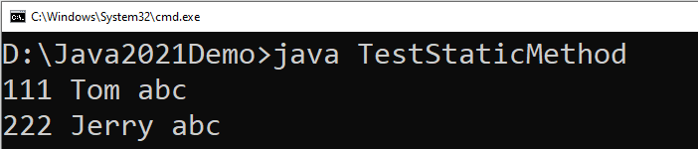
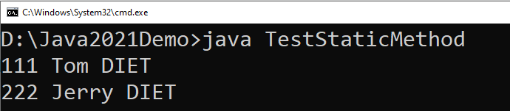
class Student {
int rollno;
String name;
static String college="abc";
static void change() {
college = "DIET";
rollno = 10;
}
Student(int r, String n) {
rollno = r;
name = n;
}
void display() {
System.out.println(rollno+" "+name+" "+college);
}
}
class TestStaticMethod {
public static void main(String args[]) {
Student.change();
Student s1 = new Student(111,"Tom");
Student s2 = new Student(222,"Jerry");
s1.display();
s2.display();
}
}
We can not use non-static variables in static methods

Slide 16
static block
static block is executed exactly once, when the class is first loaded.
It is used to initialize static variables of the class.
It will be executed even before the main method.
Syntax:
static {
//initialisation of static variables…
}

Slide 17
Inheritance
The mechanism of deriving a new class from an old class is called inheritance or derivation.
The old class is known as base class while new class is known as derived class or subclass.
It lets programmers create new classes that share some of the attributes of existing classes.
Inheritance lets us build on previous work without reinventing the wheel.
The inheritance is the most powerful feature of OOP.
Through effective use of inheritance, we can save lot of time in programming and also reduce errors, which in turn will increase the quality of work and productivity.

Slide 18
Inheritance
Employee
Manager
Worker
- ID
- Name
- Address
- Contact
- ID
- Name
- Address
- Contact
- MonthlySalary
- ID
- Name
- Address
- Contact
- DailySalary
- NoOfHours

Slide 19
Inheritance using extends keyword
When a Class extends another class it inherits all non-private members including fields and methods.
Inheritance in Java can be best understood in terms of Parent and Child relationship, also known as Super class(Parent) and Sub class(Child).
Inheritance defines IS-A relationship between a Super class and its Sub class.
For Example :
  Car IS A Vehicle
  Bike IS A Vehicle
  EngineeringCollege IS A College
  MedicalCollege IS A College
  MCACollege IS A College
extends is the keyword used to implement inheritance.

Slide 20
extends
Syntax :
Vehicle
noOfPassanger
maxSpeed
noOfWheels
noOfGears
noOfPassanger
maxSpeed
noOfWheels
noOfGears
noOfPassanger
maxSpeed
noOfWheels
noOfGears
noOfPassanger
maxSpeed
noOfWheels
noOfGears
class A {
// code
}
class B extends A{
// code
}
extends
extends
extends
Example:
Bike
cubicCapacity
isMoped
Bike
cubicCapacity
isMoped
Car
horsePower
noOfAirBags
tollTaxAmount()
Car
horsePower
noOfAirBags
tollTaxAmount()
Truck
horsePower
loadingCapacity
payTollTax()
Truck
horsePower
loadingCapacity
payTollTax()
class Vehicle {
. . . . . .
}
class Bike extends Vehicle{
. . . . . .
}
class Car extends Vehicle{
. . . . . .
}

Slide 21
Example (Inheritance)
class Vehicle {
  int noOfPassanger;
  int maxSpeed;
  public void display() {
    System.out.println("Passangers = " + noOfPassanger);
    System.out.println("Max Speed = " + maxSpeed);
  }
}
class Car extends Vehicle {
  double horsePower;
  int noOfAirbags;
  public void display() {
    System.out.println("Passangers = " + noOfPassanger);
    System.out.println("Max Speed = " + maxSpeed);
    System.out.println("Hourse Power = " + horsePower);
    System.out.println("Airbags = " + noOfAirbags);
  }
}

Slide 22
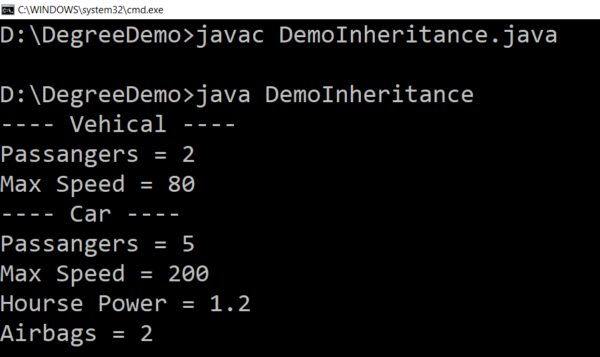
Example (Inheritance) (Cont.)
public class DemoInheritance {
  public static void main(String ar[]) {
    Vehicle v = new Vehicle();
    v.maxSpeed = 80;
    v.noOfPassanger = 2;
    System.out.println("---- Vehicle ----");
    v.display();
    Car c = new Car();
    c.maxSpeed = 200;
    c.noOfPassanger = 5;
    c.horsePower = 1.2;
    c.noOfAirbags = 2;
    System.out.println("---- Car ----");
    c.display();
  }
}

Slide 23
Types of Inheritance in Java
1. Single Inheritance
2. Hierarchical Inheritance
3. Multilevel Inheritance
A
A
A
B
B
C
B
C
4. Multiple Inheritance
5. Hybrid Inheritance
A
B
A
Note: Multiple and Hybrid Inheritance is not supported in Java with the Class Inheritance, we can still use those Inheritance with Interface which we will learn in later part of the Unit
C
B
C
D

Slide 24
Inheritance (Cont.)
Each Java class has one (and only one) superclass.
  C++ allows multiple inheritance
  BUT
  Java does not support multiple inheritance
There is no limit to the number of subclasses a class can have
Inheritance creates a class hierarchy
  Classes higher in the hierarchy are more
  general and more abstract
  Classes lower in the hierarchy are more
  specific and concrete
There is no limit to the depth of the class tree.
Class
Class
Class
Class
Class
Class
Class
Class
Class
Class
Class

Slide 25
Object class
Object class is super class of all the classes.
The Object class is defined in the java.lang package
Object
….
….
….
….
….
….
….
….
….
….
….
….
….

Slide 26
Overriding methods
Subclasses inherit all methods from their superclass
  Sometimes, the implementation of the method in the superclass does not provide the functionality required by the subclass.
  In these cases, the method must be overridden.
Rules for Method overriding
  Method signature must be same as of Super Class method.
  The return type should be the same.
  The access level cannot be more restrictive than the overridden method's access level.
    Example :
      protected -> public // is allowed
      protected -> private // is not allowed

Slide 27
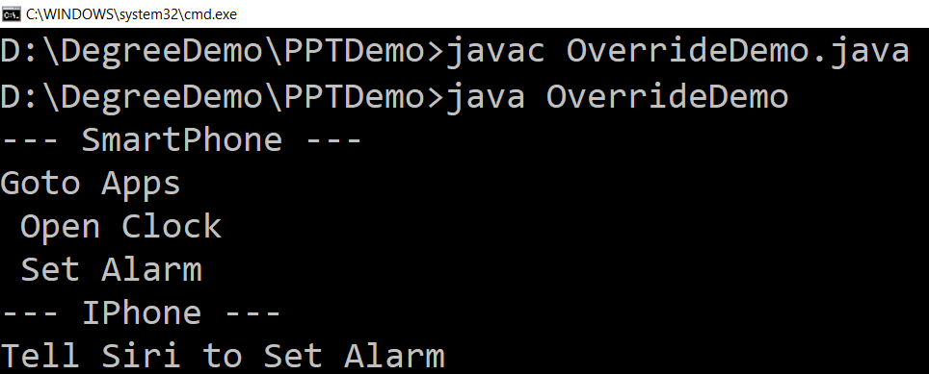
Overriding (Example)
class SmartPhone{
  public void setAlarm(){
  System.out.println
  ("Goto Apps\n
  Open Clock\n
  Set Alarm");
  }
}
class IPhone extends SmartPhone
{
  public void setAlarm()
  {
  System.out.println
  ("Tell Siri to Set Alarm");
  }
}
public class OverrideDemo {
  public static void main(String[] ar) {
    SmartPhone s = new SmartPhone();
    System.out.println("--- SmartPhone ---");
    s.setAlarm();
    IPhone i = new IPhone();
    System.out.println("--- IPhone ---");
    i.setAlarm();
  }
}

Slide 28
super keyword
The super keyword in Java is a reference variable which is used to refer immediate parent class object.
The most common use of the super keyword is to eliminate the confusion between super classes and subclasses that have methods with the same name.
Usage of Java super Keyword
  super can be used to refer immediate parent class instance variable.
  super can be used to invoke immediate parent class method.
  super() can be used to invoke immediate parent class constructor.

Slide 29
super keyword
class A
{ int i=10;
A()
{ System.out.println("hi");}
void f1()
{ System.out.println("hello"); }
}
class B extends A
{ int i=20;
B()
{
super();
}
void f2()
{ super.f1();
System.out.println(super.i+this.i);
}
public static void main(String args[])
{ B obj=new B();
obj.f2();
}
}

Slide 30
Constructors in Inheritance
Classes use constructors to initialize instance variables
  When a subclass object is created, its constructor is called after the superclass default constructor.
  It is the responsibility of the subclass constructor to invoke the appropriate superclass constructors so that the instance variables defined in the superclass are properly initialized
Superclass constructors can be called using the "super" keyword in a manner similar to "this"
  It must be the first line of code in the constructor
If a call to super is not made, the system will automatically invoke the no-argument constructor of the superclass.

Slide 31
“final” keyword
The final keyword is used for restriction.
final keyword can be used in many context
Final can be:
  Variable
    If you make any variable as final, you cannot change the value of final variable(It will be constant).
  Method
    If you make any method as final, you cannot override it.
  Class
    If you make any class as final, you cannot extend it.

Slide 32
1) “final” as a variable
Can not change the value of final variable.
public class FinalDemo {
final int speedlimit=90;//final variable
void run(){
speedlimit=400;
}
public static void main(String args[]){
    FinalDemo obj=new FinalDemo();
  obj.run();
}
}
final

Slide 33
2) “final” as a method
If you make any method as final, you cannot override it.
class BikeClass{
final void run(){
System.out.println("Running Bike");
}
}
class Pulsar extends BikeClass{
void run(){
System.out.println("Running Pulsar");
}
public static void main(String args[]){
Pulsar p= new Pulsar();
p.run();
}
}
final

Slide 34
3) “final” as a Class
If you make any class as final, you cannot extend it.
final
final class BikeClass{
void run(){
System.out.println("Running Bike");
}
}
class Pulsar extends BikeClass
{
void run(){
System.out.println("Running Pulsar");
}
public static void main(String args[]){
Pulsar p= new Pulsar();
p.run();
}
}

Slide 35
Finalize method
The Java finalize() method of Object class is a method that the Garbage Collector always calls just before the deletion/destroying the object which is eligible for Garbage Collection to perform clean-up activity.
Clean-up activity means closing the resources associated with that object like Database Connection, Network Connection, or we can say resource de-allocation.
Finalization: Just before destroying any object, the garbage collector always calls finalize() method to perform clean-up activities on that object. This process is known as Finalization in Java.
Syntax: protected void finalize()
{
// code of finalization
}

Slide 36
Abstract class
Abstraction is a process of hiding the implementation details from the user, only the functionality will be provided to the user.
In other words, the user will have the information on what the object does instead of how it does it.
Abstraction is achieved using Abstract classes and interfaces.
A class which contains the abstract keyword in its declaration is known as abstract class.
  Abstract classes may or may not contain abstract methods, i.e., methods without body ( public void get(); )
  But, if a class has at least one abstract method, then the class must be declared abstract.
  If a class is declared abstract, it cannot be instantiated.
  To use an abstract class, you have to inherit it to another class and provide implementations of the abstract methods in it.

Slide 37
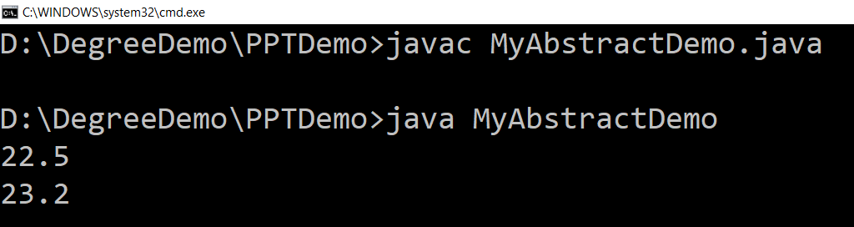
Abstract class (Example)
abstract class Car {
public abstract double getAverage();
}
class Swift extends Car{
  public double getAverage(){
  return 22.5;
}
}
class Baleno extends Car{
    public double getAverage(){
    return 23.2;
    }
}
public class MyAbstractDemo{
    public static void main(String ar[]){
      Swift b1 = new Swift();
      Baleno b2 = new Baleno();
      System.out.println(b1.getAverage());
      System.out.println(b2.getAverage());
    }
}

Slide 38
Interface
An interface is similar to an abstract class with the following exceptions
  All methods defined in an interface are abstract. Interfaces can contain no implementation
  Interfaces cannot contain instance variables. However, they can contain public static final variables (ie. constant class variables)
Interfaces are declared using the "interface" keyword
If an interface is public, it must be contained in a file which has the same name
Interfaces are more abstract than abstract classes
Interfaces are implemented by classes using the "implements" keyword

Slide 39
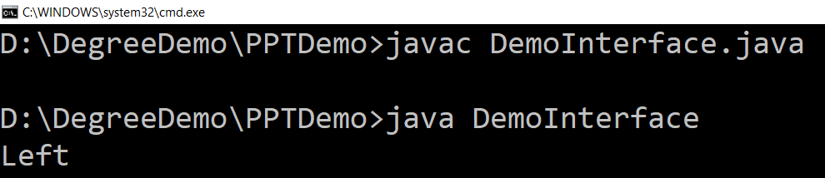
Interface (Example)
interface VehicalInterface {
  int a = 10;
  public void turnLeft();
  public void turnRight();
  public void accelerate();
  public void slowDown();
}
class CarClass implements VehicalInterface
{
  public void turnLeft() {
  System.out.println("Left");
  }
  public void turnRight() {
  System.out.println("Right");
  }
  public void accelerate() {
  System.out.println("Speed");
  }
  public void slowDown() {
  System.out.println("Break");
  }
}
Here access specifier of method must be public
public class DemoInterface{
  public static void main(String[] a)
  {
    CarClass c = new CarClass();
    c.turnLeft();
  }
}
Variable in interface are by default
public, static, final
We have to provide implementation to all the methods of the interface

Slide 40
Interface V/S Abstract Class
Interface | Abstract Class
Interface support multiple inheritance | Abstract class does not support multiple inheritance
Interface does not contains Constructor | Abstract class contains Constructor
An interface contains only incomplete /abstract methods | An abstract class contains both incomplete and complete methods
An interface cannot have access modifiers, so by default everything is public. | An abstract class can contain access modifiers for the functions, properties
Methods of interface cannot be static | Only complete Methods of abstract class can be static
Variables declared in interface are public, static, final by default. | An abstract class may contain non-final variables.
Interface should be implemented using keyword “implements”. | Abstract class should be extended using keyword “extends”.

Slide 41
Dynamic Method Dispatch
Method overriding is one of the ways in which Java supports Runtime Polymorphism.
Dynamic method dispatch is the mechanism by which a call to an overridden method is resolved at run time, rather than compile time.
A superclass reference variable can refer to a subclass object, This is also known as upcasting.
Static Binding | Dynamic Binding
Occurs during compile time | Occurs during runtime
It uses type(Class) information for binding | It uses instance of class(Object) to resolve calling of method
Overloaded methods are bonded using static binding | Overridden methods are bonded using dynamic binding
Static binding means when the type of object which is invoking the method is determined at compile time by the compiler | Dynamic binding means when the type of object which is invoking the method is determined at run time by the compiler

Slide 42
Dynamic Method Dispatch (Example)
class Game {
public void type() {
  System.out.println("Indoor & outdoor");
}
}
class Cricket extends Game {
public void type() {
  System.out.println("outdoor game");
}
}
class Badminton extends Game {
public void type() {
  System.out.println("indoor game");
}
}
class Tennis extends Game {
public void type() {
  System.out.println("Mix game");
}
}
public class MyProg {
  public static void main(String[] args) {
    Game g= new Game();
    Cricket c = new Cricket();
    Badminton b = new Badminton();
    Tennis t = new Tennis();
    Scanner s = new Scanner(System.in);
    System.out.print("Please Enter name \n
    of the game = ");
    String op = s.nextLine();
    if (op.equals("cricket")) {
    g = c;
    } else if (op.equals("badminton")) {
    g = b;
    } else if (op.equals("tennis")) {
    g = t;
    }
    g.type();
  }
}

Slide 43
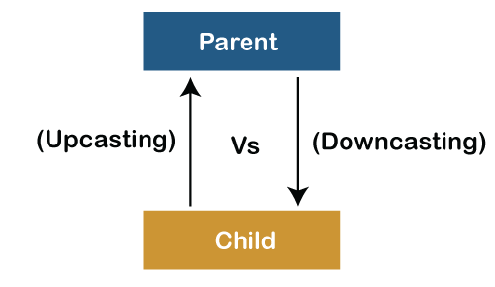
Upcasting and Downcasting
In Java, the object can also be typecasted like the datatypes. Parent and Child objects are two types of objects. So, there are two types of typecasting possible for an object, i.e., Parent to Child and Child to Parent

Slide 44
Dynamic Method Dispatch (Example)
class Parent{
void PrintData() {
System.out.println("method of parent class");
}
}
class Child extends Parent {
void PrintData() {
System.out.println("method of child class");
}
}
class UpcastingExample{
public static void main(String args[]) {
Parent obj1 = (Parent) new Child();
Parent obj2 = (Parent) new Child();
obj1.PrintData();
obj2.PrintData();
} }
class Parent {
String name;
void showMessage()
{
System.out.println("Parent method is called");
} }
class Child extends Parent {
int age;
void showMessage()
{
System.out.println("Child method is called");
} }
public class Downcasting{
public static void main(String[] args)
{ Parent p = new Child();
p.name = "Shubham";
Child c = (Child)p;
c.age = 18;
System.out.println(c.name);
System.out.println(c.age);
c.showMessage(); }

Slide 45
Practice Programs
The abstract Vegetable class has three subclasses named Potato, Brinjal and Tomato. Write a java prog. That demonstrates how to establish this class hierarchy. Declare one instance variable of type String that indicates the color of a vegetable. Crete and display instances of these objects. Override the toString() method of object to return a string with the name of vegetable and its color.
Declare a class called Book having book title & author name as members. Create a sub-class of it, called BookDetails having price & current stock of book as members. Create an array for storing details of n books. Define methods to achieve following:
- Initialization of members
- To query availability of a book by author name / book title
- To update stock of a book on purchase and sell
- Define method main to show usage of above methods.

Slide 46

Object Oriented Programming using Java (2304CS302)
Prof. Chirag K Sakhrani
Department of Computer Applications
chirag.sakhrani@darshan.ac.in
8401191184

